Slide 1

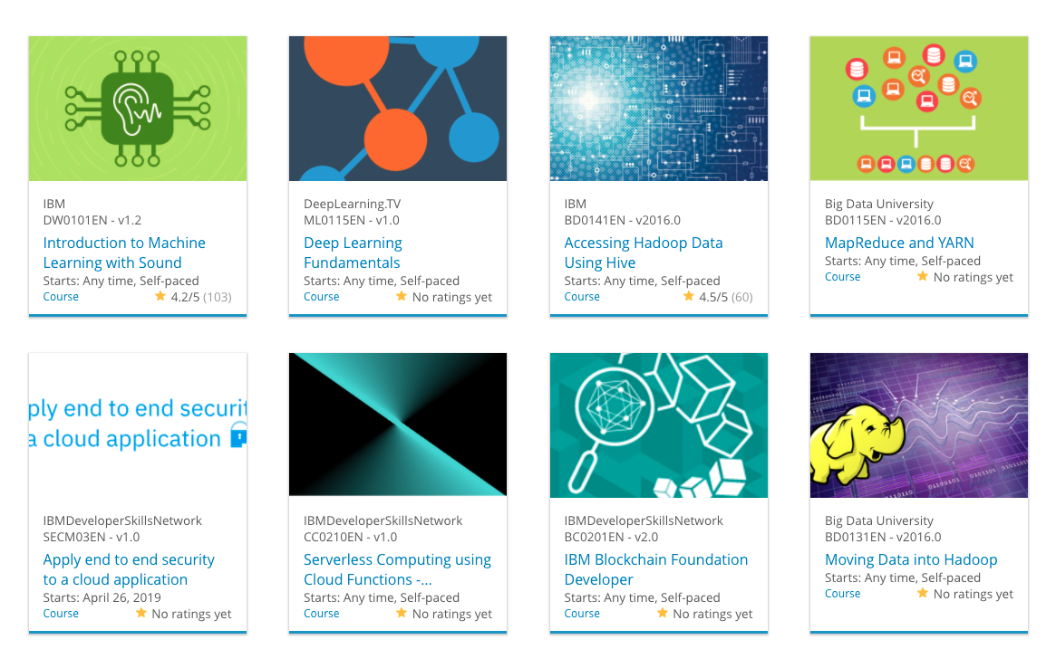
Build a Personalized Online Course Recommender System with Machine Learning
Hasan Soufan
07-04-2026

Slide 2
Outline
Introduction and Background
Exploratory Data Analysis
Content-based Recommender System using Unsupervised Learning
Collaborative-filtering based Recommender System using Supervised learning
Conclusion
Appendix

Slide 3
Introduction
Learner across the world increasingly seek to acquire skills in leading technologies such as Machine Learning, Ai, Data Science, Cloud, App Development, etc, However with the growing number of available courses, it becomes difficult for the learners to identify relevant content efficiently. To improve the learning experience a recommender system can users discover aligned with their interests and effectively guide their learning path.
Currently, learners struggle to discover relevant courses due to the large volume of available content. This led to inefficient course selection and reduced engagement, ultimately affecting learning outcomes and platform effectiveness.

Slide 4
Exploratory Data Analysis

Slide 5
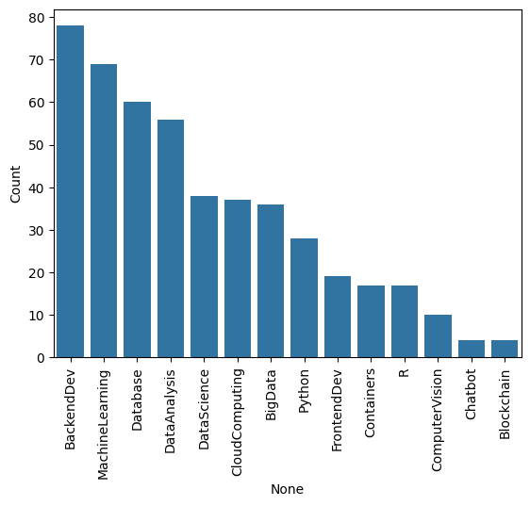
Course counts per genre
This chart shows the distribution of courses enrollments across different categories.
The x axis represent the courses genre, and the y axis show the number of enrollments.
We can see that BackendDev has the highest enrollments and the Blcokchain has the lowest.
Following the trend we can see the learners are more interstead in Data, ML and Backend skills.

Slide 6
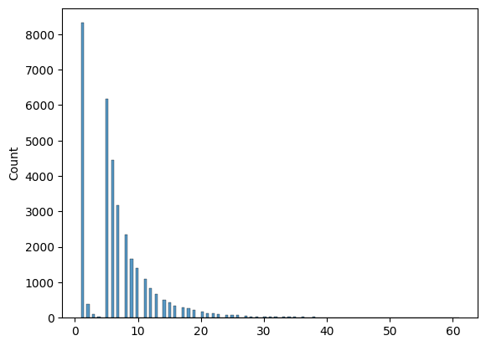
Course enrollment distribution
This chart shows the distribution of courses enrollments across users.
The x axis represent the courses number, and the y axis show the number of users (count).
most users are concentrated below 10 courses.
The distribution is skewed to the right indicating that while most users take few courses, a small number of users enroll in many courses

Slide 7
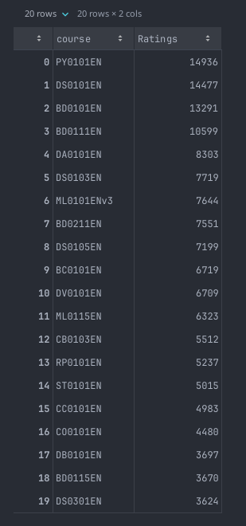
20 most popular courses
The top 20 courses show a clear concentration of enrollments in a few highly popular courses, with the top courses exceeding 13000 enrollments.
After the top 5, there is noticeable drop, with enrollments decreasing to around 8000 and below.
This indicate that a small number of courses dominate users interest.

Slide 8
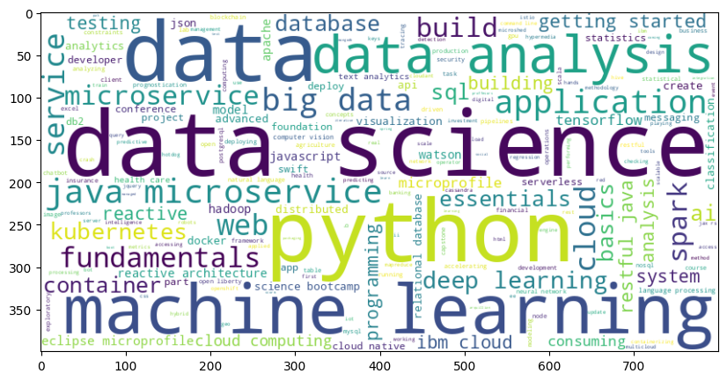
Word cloud of course titles
This word cloud represent the most frequent keywords across the courses titles and descriptions, larger words indicate higher frequency and importance.
We can observe that words like data science, data, python and machine learning dominate, suggesting a strong focus on data-driven and AI related topics.

Slide 9
Content-based Recommender System using Unsupervised Learning
Cluster2
Cluster1

Slide 10

Flowchart of content-based recommender system using user profile and course genres
Starting by getting the user data then creating vectors for each profile after that selecting the unseen candidates, then we calculate the similarity scores, applying the recommendation threshold, finally getting the recommended scores.

Slide 11
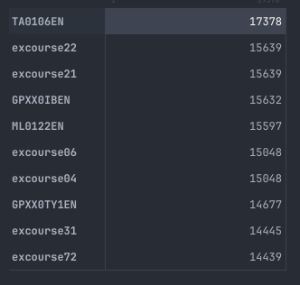
Evaluation results of user profile-based recommender system
Recommendation Score Threshold: 10.0
On average, 60 courses have been recommended per user.
- the top-10 commonly recommended courses across all users

Slide 12
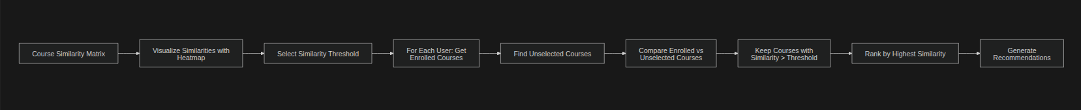
Flowchart of content-based recommender system using course similarity
Starting by getting the course similarity Matrix then visualizing heatmap, select threshold, after that for each user selecting the unseen candidates, then we calculate the similarity scores, applying the recommendation threshold, finally getting the recommended scores.

Slide 13
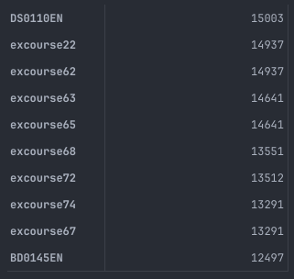
Evaluation results of course similarity based recommender system
Recommendation Score Threshold: 0.6
On average, 9.7 courses have been recommended per user.
- the top-10 commonly recommended courses across all users

Slide 14
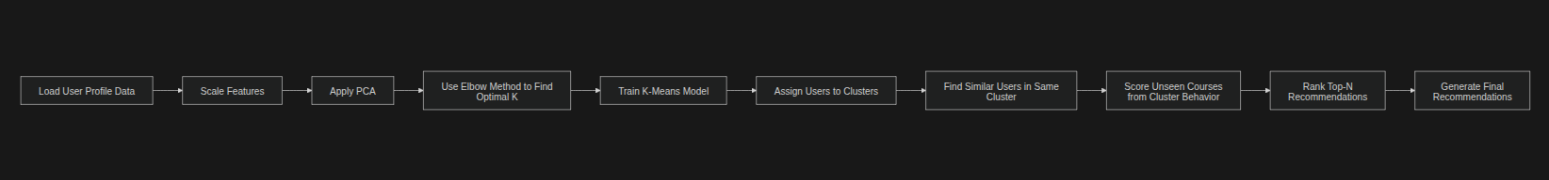
Flowchart of clustering-based recommender system
The flow starts by preprocessing user data through scaling and dimensionality reduction (PCA), followed by selecting the optimal number of clusters using the elbow method and training a K-Means model. Users are then grouped into clusters, where similar users are identified based on cluster membership. Finally, recommendations are generated by ranking unseen courses according to their popularity within each user’s cluster.

Slide 15
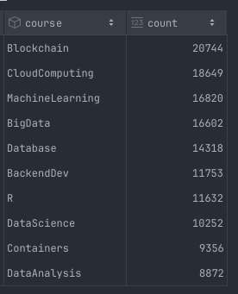
Evaluation results of clustering-based recommender system
PCA variation: 0.95, KMeans n_init: 10, n_clusters: 9
On average, each user receives approximately 4.89 new (unseen) course recommendations out of the top 5 recommendations.
- the top-10 commonly recommended courses across all users

Slide 16
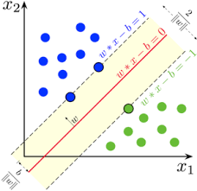
Collaborative-filtering Recommender System using Supervised Learning

Slide 17
Flowchart of KNN based recommender system
Plot a flowchart which should clearly illustrate how you performed KNN based recommender system using course enrollments history
- Briefly explain the flowchart in the slide note
An example flowchart may look like the following:
Raw data
Data processing
Cleaned datasets
Feature engineering
Features

Slide 18
Flowchart of NMF based recommender system
- Plot a flowchart which should clearly illustrate how you performed NMF based recommender system
- Briefly explain the flowchart in the slide note
An example flowchart may look like the following:
Raw data
Data processing
Cleaned datasets
Feature engineering
Features

Slide 19
Flowchart of Neural Network Embedding based recommender system
- Plot a flowchart which should clearly illustrate how you performed Neural Network Embedding based recommender system
- Briefly explain the flowchart in the slide note
An example flowchart may look like the following:
Raw data
Data processing
Cleaned datasets
Feature engineering
Features

Slide 20
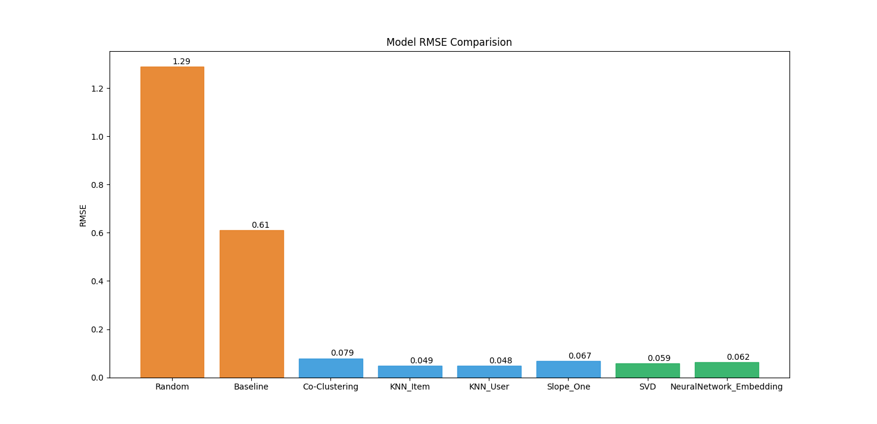
Compare the performance of collaborative-filtering models
Plot a barchart visualizing the performance metric (such as RMSE) of different collaborative-filtering models you have built so far
Briefly explain the barchart in the slide note
A sample barchart may look like the following

Slide 21
Optional: Build a course recommender system app with Streamlit
Streamlit app screenshot1
Streamlit app screenshot2
A published Streamlit App URL for a live demo

Slide 22
Conclusions
Point 1
Point 2
Point 3
Point 4
…

Slide 23
Appendix
Instructions for learner:
Include any relevant assets like a GitHub repo, key Python code snippets, charts, notebook outputs, or deployed Streamlit app URLs that you may have created during this project
Asset 1
Asset 2
Asset 3
Asset 4
…

